Slide 1
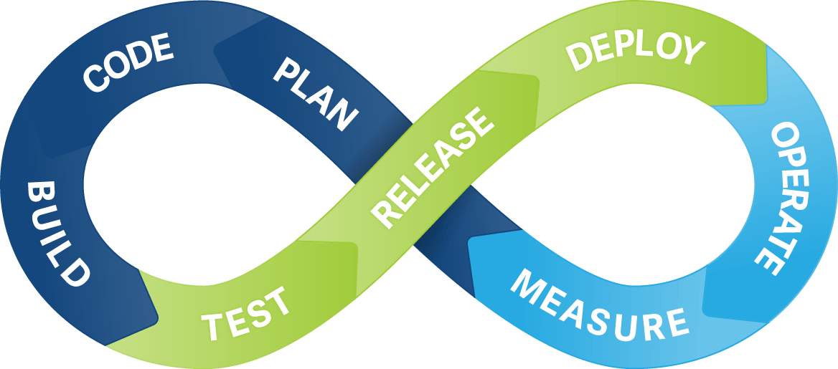
Continuous Integration & Deployment

Slide 2
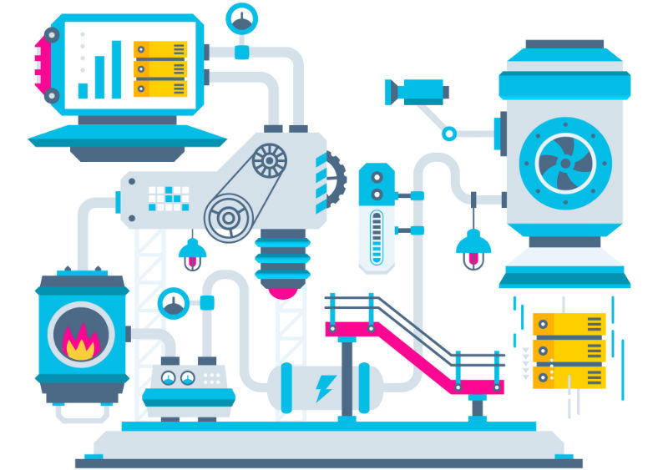
What is an Continuous Integration?
Continuous Integration (CI) is a development practice that requires developers to integrate code into a shared repository several times a day. Each check-in is then verified by an automated build, allowing teams to detect problems early.
Notes:
Developers practicing continuous integration merge their changes back to the main branch as often as possible. The developer's changes are validated by creating a build and running automated tests against the build. By doing so, you avoid the integration hell that usually happens when people wait for release day to merge their changes into the release branch.

Slide 3
What we neeD
Continuous Integration
What we Gain
Automated tests
Continuous integration server
Merge our changes more often
Less bugs get shipped to production
Building the release is easy
Less context switching
Economy testing costs
Notes:
What we need:
Our team will need to write automated tests for each new feature, improvement or bug fix.
We need a continuous integration server that can monitor the main repository and run the tests automatically for every new commits pushed.
Developers need to merge their changes as often as possible, at least once a day.
What we gain:
Less bugs get shipped to production as regressions are captured early by the automated tests.
Building the release is easy as all integration issues have been solved early.
Less context switching as developers are alerted as soon as they break the build and can work on fixing it before they move to another task.
Testing costs are reduced drastically – your CI server can run hundreds of tests in the matter of seconds.

Slide 4

What is an Continuous Deployment?
Continuous deployment is an extension of continuous integration. With this practice, every change that passes all stages of your production pipeline is released to your customers.
There's no human intervention, and only a failed test will prevent a new change to be deployed to production.
Notes:
“Every change that passes all stages of our production pipeline is released.”
Does it means that changes can be released in parts related to passing test?

Slide 5
What we neeD
Continuous Deployment
What we Gain
High quality tests
Actual documentation
Using flag features (recommended)
Faster development
Releases are less risky
Satisfied customer
Notes:
What we need:
Our testing culture needs to be at its best. The quality of your test suite will determine the quality of your releases.
Our documentation process will need to keep up with the pace of deployments.
Feature flags become an inherent part of the process of releasing significant changes to make sure you can coordinate with other departments (Support, Marketing, PR...).
What we gain:
You can develop faster as there's no need to pause development for releases. Deployments pipelines are triggered automatically for every change.
Releases are less risky and easier to fix in case of problem as you deploy small batches of changes.
Customers see a continuous stream of improvements, and quality increases every day, instead of every month, quarter or year.

Slide 6
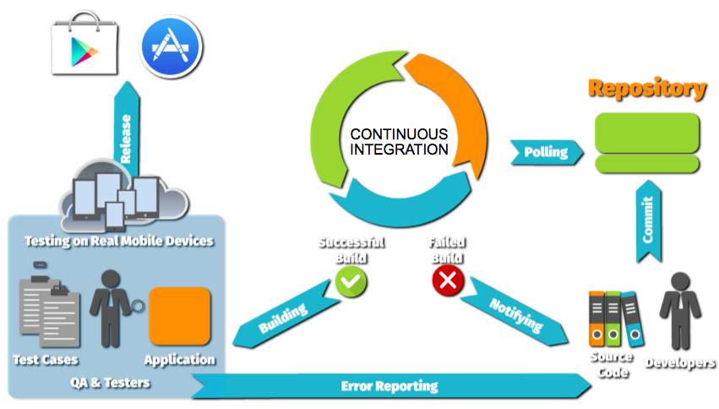
Scheme of work

Slide 7
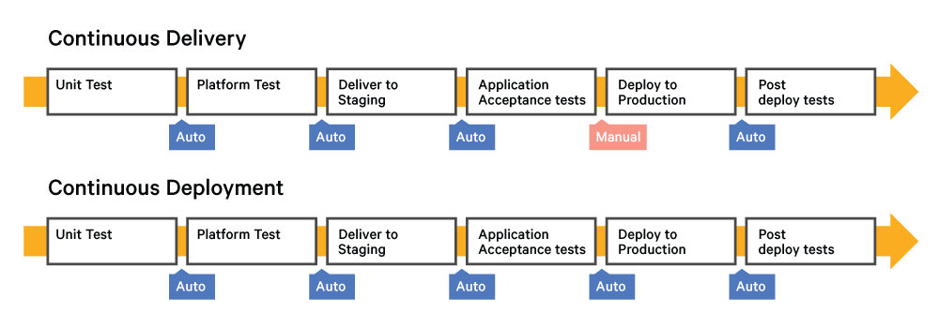
CD – Continuous Deployment or delivery?
Continuous Integration
Notes:
* + and – just for us
* Continuous Deployment is accelerate Continuous Delivery

